Slide 1
Places of interest in Great Britain

Slide 2
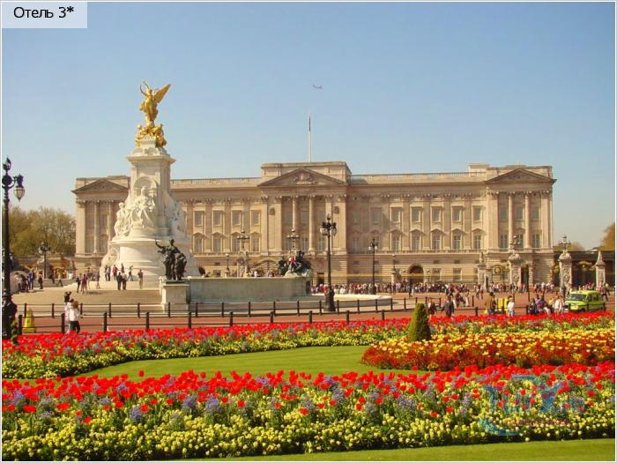
Buckingham Palace
Buckingham Palace is the Queen's official London residence and is used to receive and entertain guests on state, ceremonial and official occasions for the Royal Family. The palace was originally built in 1705 for the Duke of Buckingham.

Slide 3
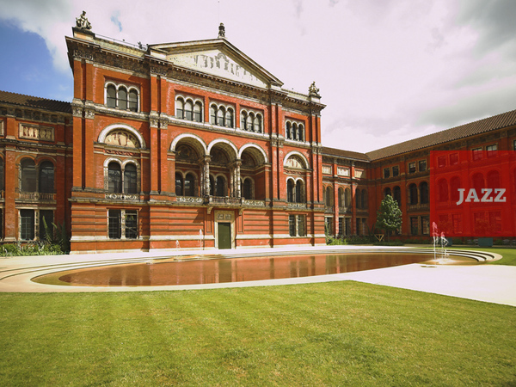
Victoria and Albert Museum
The Victoria and Albert Museum is the world's largest museum of decorative arts and design, housing a permanent collection of over 4.5 million objects. Named after Prince Albert and Queen Victoria, it was founded in 1852, and has since grown to cover 12.5 acres (51,000 m2)[2] and 145 galleries.

Slide 4
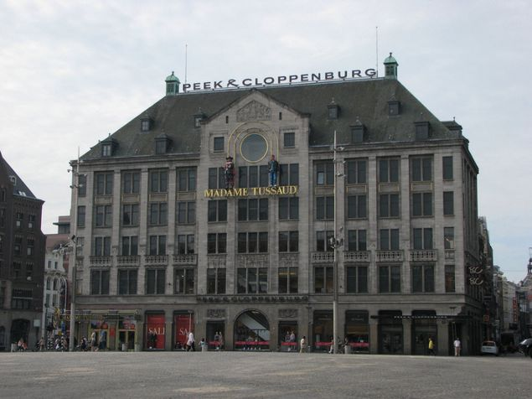
Madam Tussaud`s
Madam Tussauds is one of the most famous tourist attractions in the world. Its museums are widely spread in places like Vienna, Amsterdam, Berlin, Hollywood, Hong Kong, Las Vegas, London, New York, Shanghai and Washington DC. Madam Tussaud`s in London hosts around 400 life-size wax models of artists, politicians, sportsmen, monarchs.

Slide 5
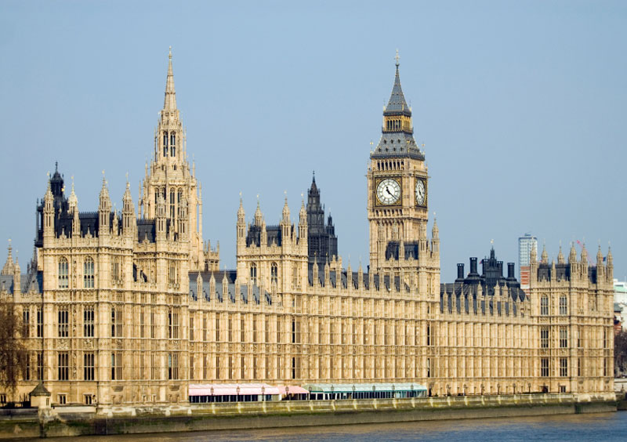
Houses of Parliament
The Houses of Parliament, also known as the Palace of Westminster is the seat of Britain's two parliamentary houses, the House of Lords and the House of Commons.

Slide 6
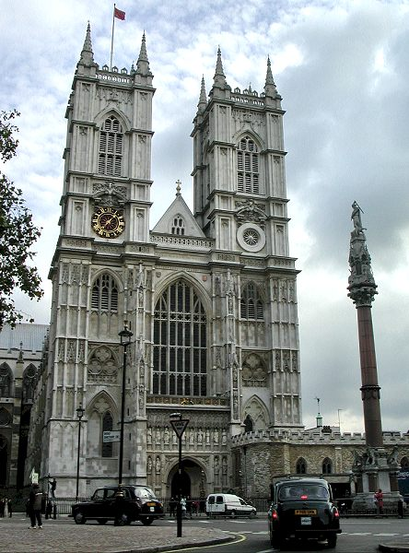
Westminster Abbey
Most of the present building dates from 1245 to 1272 when Henry III decided to rebuild the abbey in the Gothic style. The building was later significantly expanded: the Chapel of Henry VII was added between 1503 and 1512, while the two West Front Towers date from 1745. The youngest part of the abbey is the North entrance, completed in the 19th century.

Slide 7
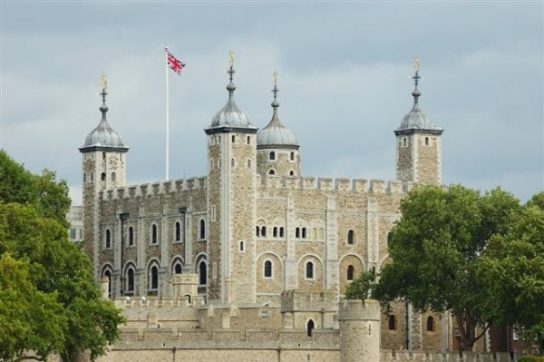
Tower of London
Construction of the Tower of London was initiated in 1070 by William the Conqueror, shortly after his victory at Hastings in 1066. The Tower was built to enforce the power of the king over the newly conquered region. The fortress, strategically located at the Thames, was originally not more than a temporary wooden building which was replaced later by the White Tower. Over time the complex was expanded into a stronghold with about 20 towers.

Slide 8
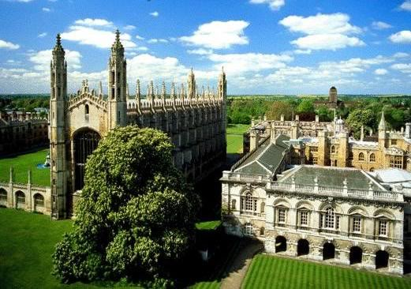
Cambridge University
The University of Cambridge is a public research university located in Cambridge, England, United Kingdom. It is the third-oldest surviving university in the world. It is considered to be one of the most prestigious institutions of higher learning in the world.

Slide 9
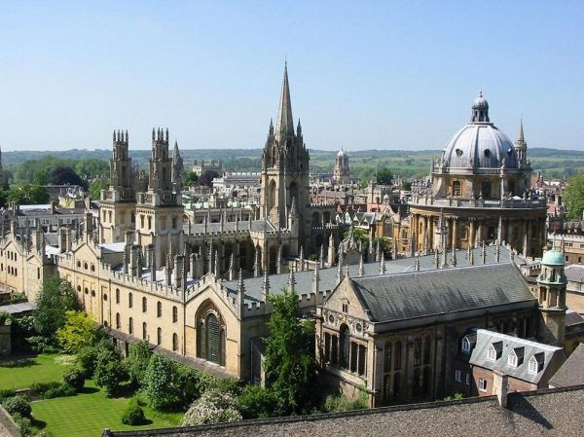
Oxford University
The University of Oxford is a collegiate research university located in Oxford, England, United Kingdom. Although its exact date of foundation is unclear, there is evidence of teaching as far back as 1096, making it the oldest university in the English-speaking world, and the second-oldest surviving university in the world, after the University of Bologna.

Slide 10
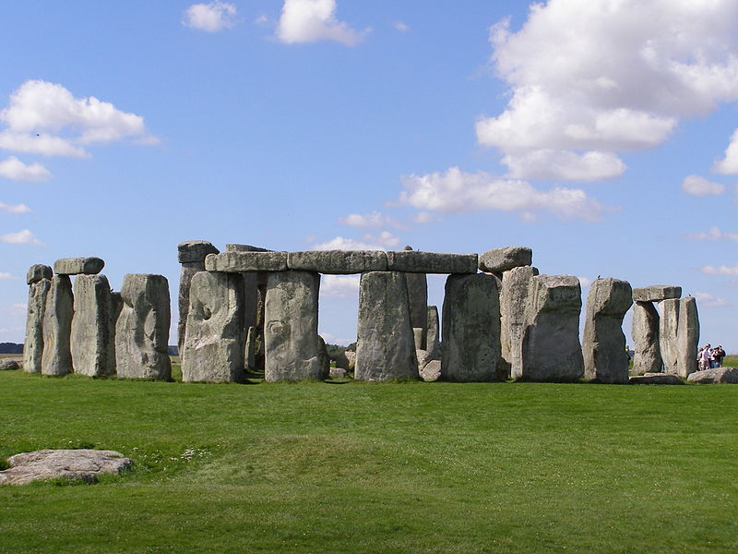
Stonehenge
Stonehenge is a prehistoric monument in Wiltshire. One of the most famous sites in the world, Stonehenge is the remains of a ring of standing stones set within earthworks. It is in the middle of the most dense complex of Neolithic and Bronze Age monuments in England, including several hundred burial mounds.

Slide 11
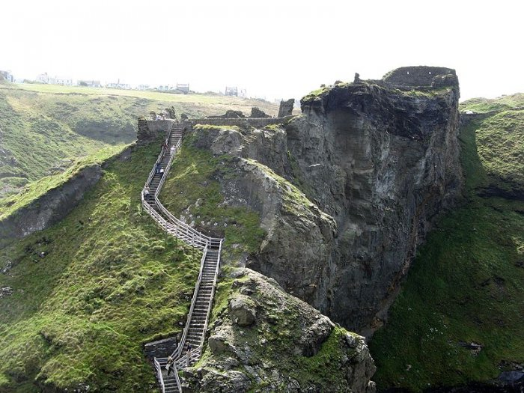
tintagel castle of king arthur
Tintagel Castle is an awe-inspiring place to visit and soak up the atmosphere generated by the dramatic views and wonderful legends. Today, the remains of Tintagel castle stand on rugged cliffs high above the sea.

Slide 12
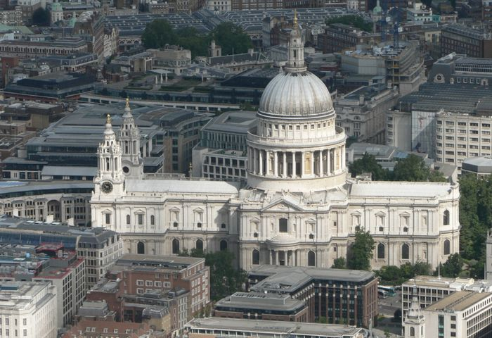
St Paul`s Cathedral
St Paul's Cathedral, is the Anglican cathedral on Lud Hill, in the City of London, and the seat of the Bishop of London. The present building dates from the 17th century and is generally reckoned to be London's fifth "St Paul's Cathedral", although the number is higher if every major medieval reconstruction is counted as a new cathedral.

Slide 13
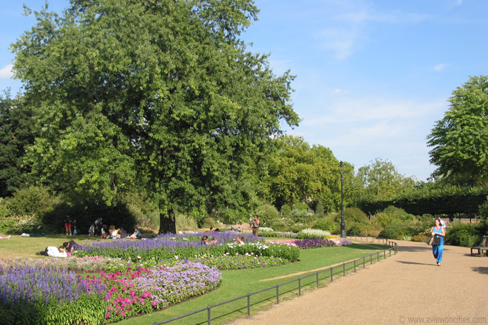
Hyde Park
Hyde Park, which opened to the public in 1637, is the largest of several royal parks in London that are connected to each other, forming one large green lung in the center of the city. The park is famous for its Speakers' Corner.

Slide 14
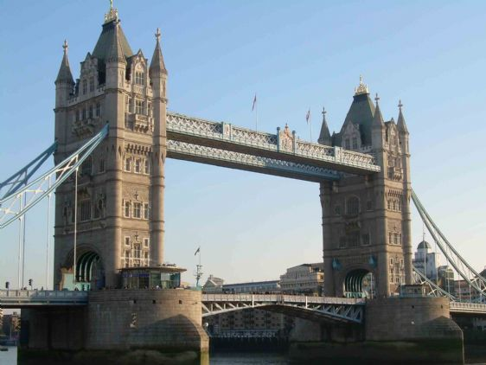
London Bridge
London Bridge refers to several historical bridges that have spanned the River Thames between the City of London and Southward, in central London. The current crossing, which opened to traffic in 1973, is a box girder bridge built from concrete and steel. This replaced a 19th-century stone-arched bridge, which in turn superseded a 600-year-old medieval structure..

Slide 15
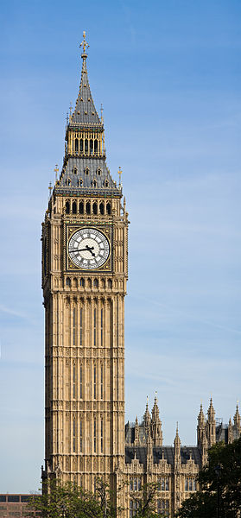
Big Ben
Big Ben is the nickname for the great bell of the clock at the north end of the Palace of Westminster in London, and often extended to refer to the clock and the clock tower. The tower is now officially called the Elizabeth Tower, after being renamed in 2012 (from "Clock Tower") to celebrate the Diamond Jubilee of Elizabeth II.

Slide 16
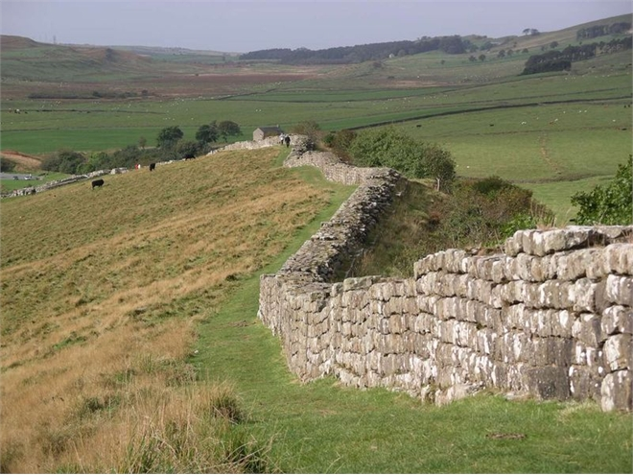
Hadrian Wall
Hadrian's Wall (Latin: Vallum Aelium) was a defensive fortification in Roman Britain, begun in AD 122 during the rule of emperor Hadrian. In addition to its military role, gates through the wall served as customs posts.

Slide 17
Підготувала:
учениця 9 класу
Данилюк Руслана

